Slide 1
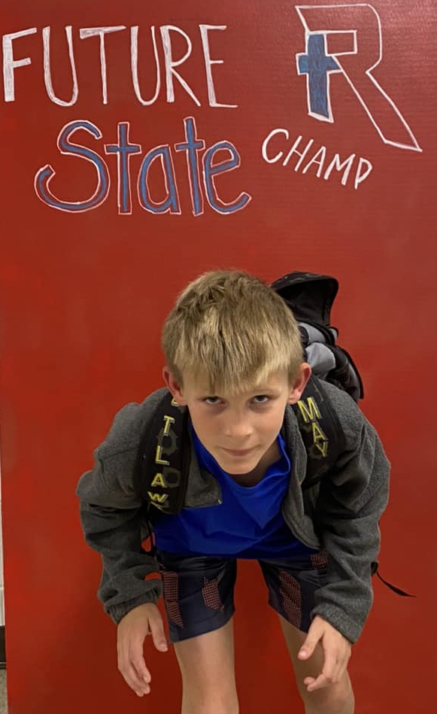
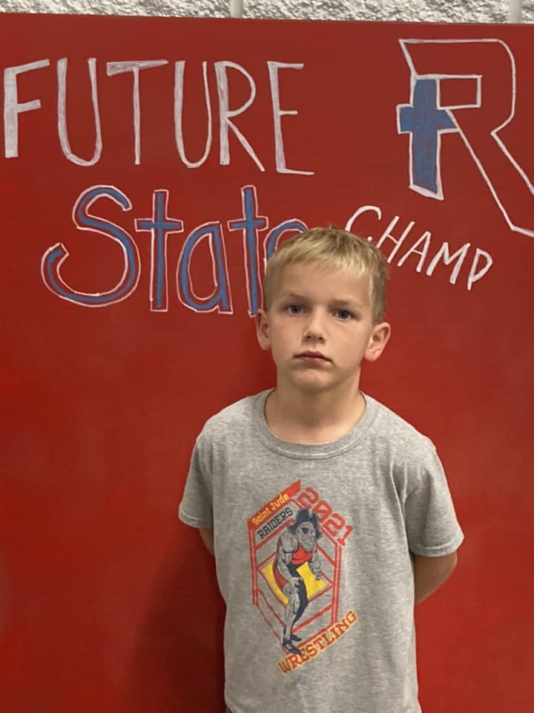
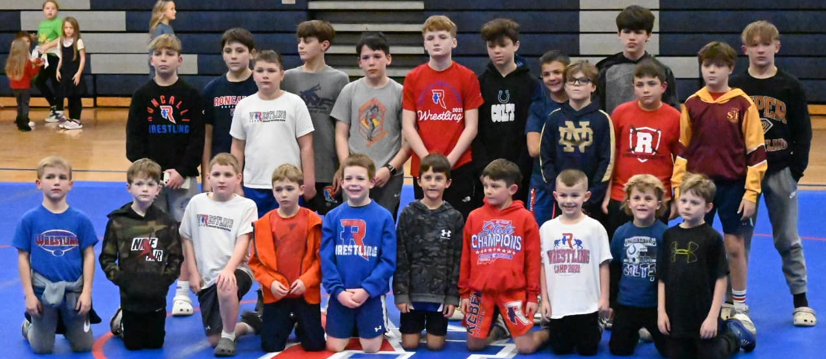
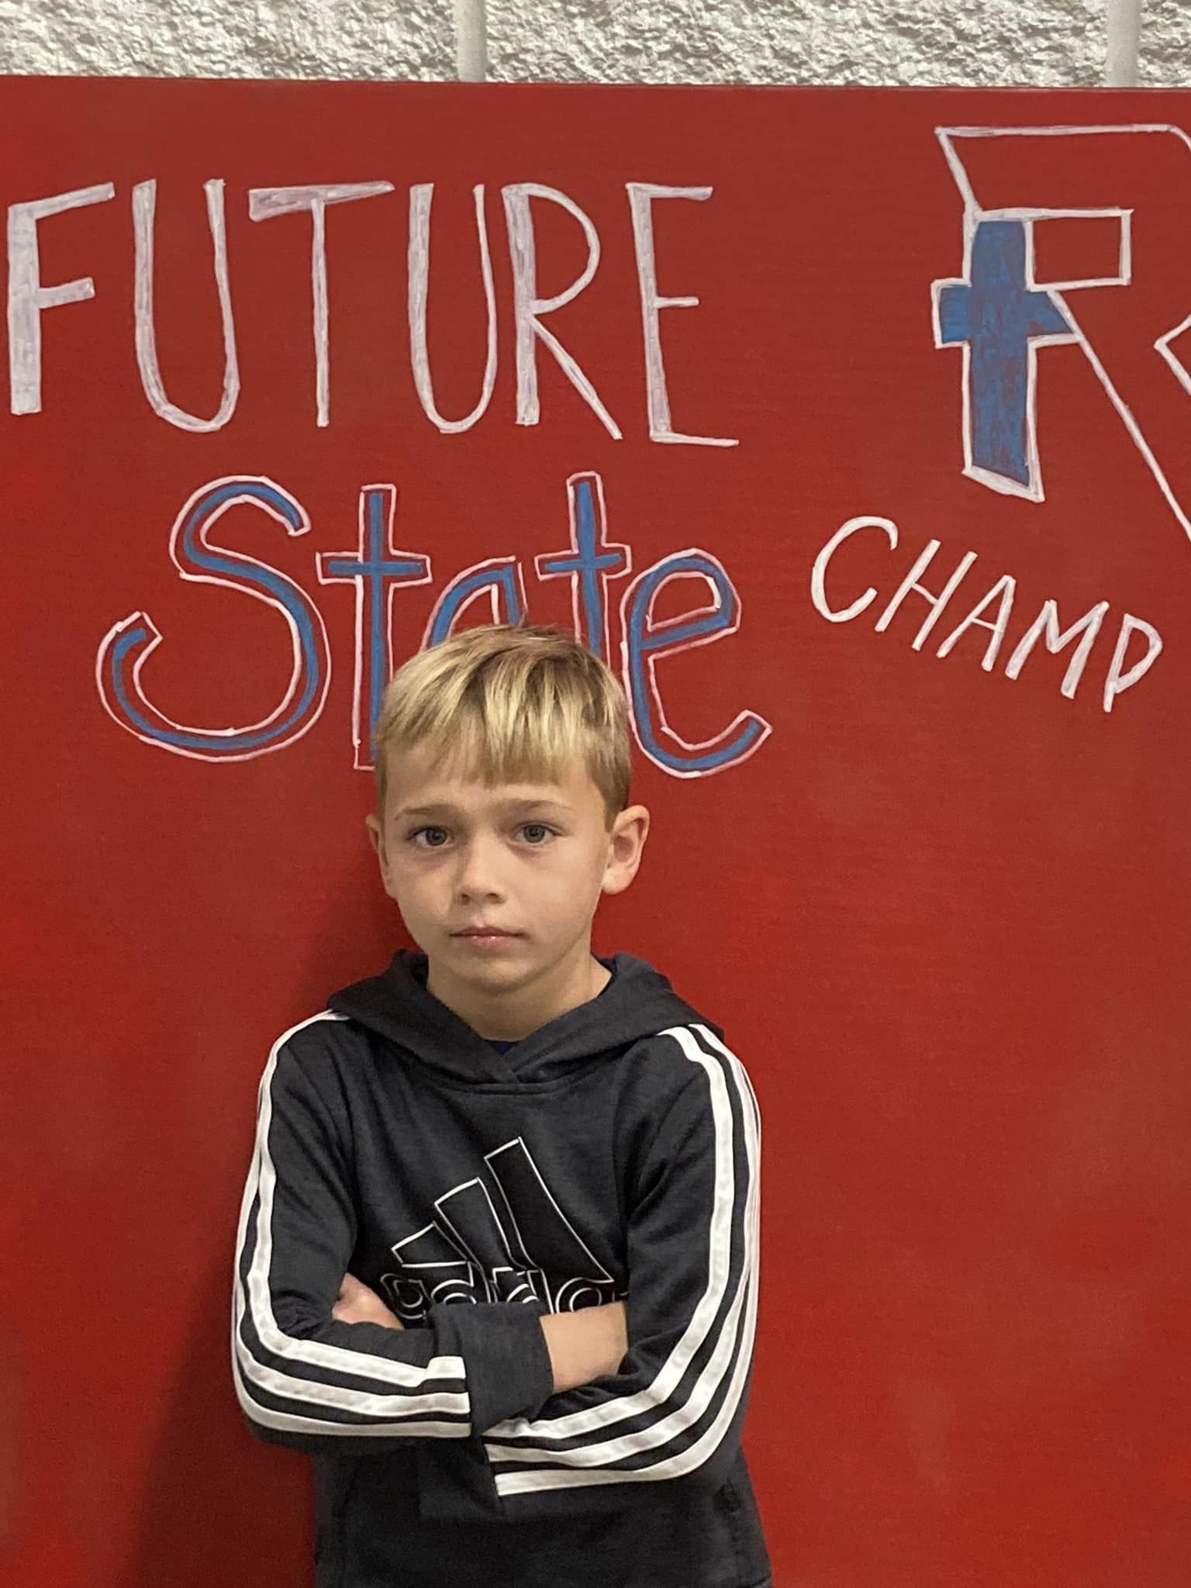

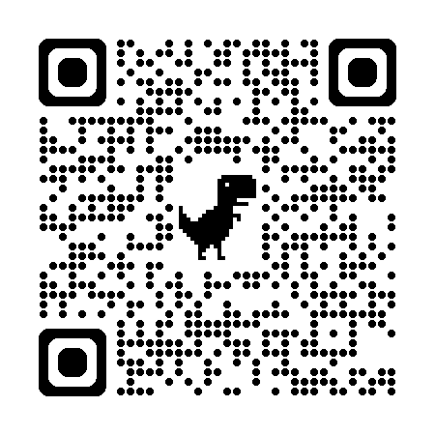
RWF Youth Wrestling Club
Future Royals

Slide 2
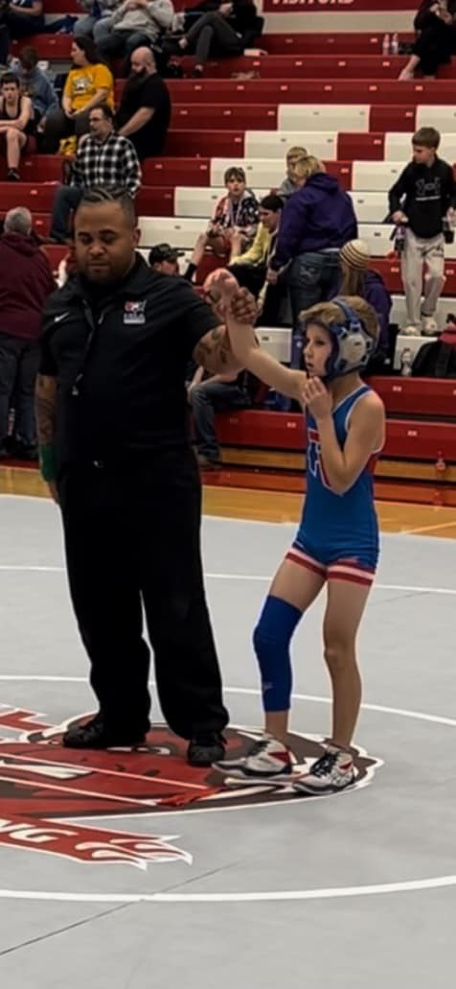
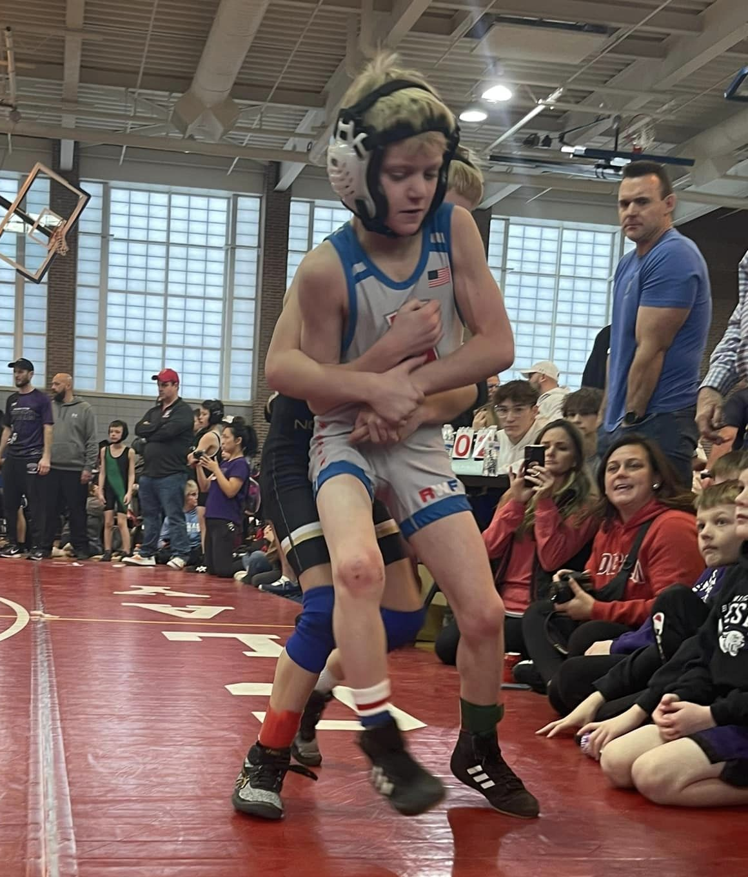
Why Wrestle?
- Builds confidence
-Wrestling requires dedication and hard work. Young wrestlers learn the value of perseverance, discipline, and commitment as they practice and train consistently. This carries over to other areas of their lives, including academics and personal growth.
- Teaches valuable lessons -
Discipline and work ethic
- Gain mental toughness and learn emotional control - Build character
- Learn Self-defense
- Physical fitness
- Flexibility, coordination, agility
- Strength, physical toughness
-Grows community
- Teamwork and friendships
- Male and Female high school mentors
- Boys and Girls welcome!

Slide 3
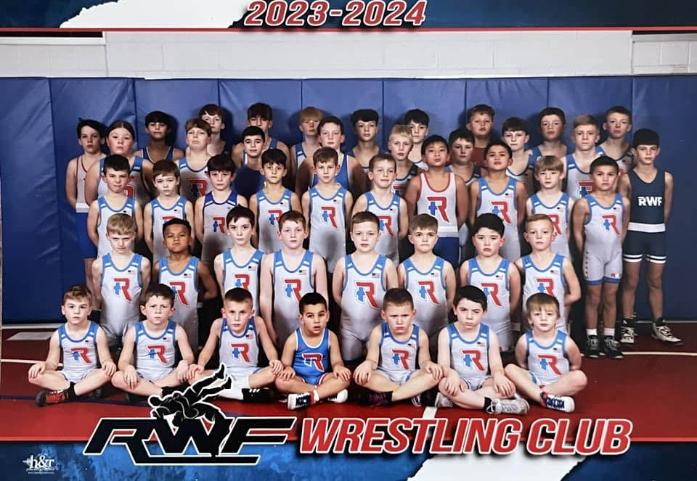
Why Roncalli Wrestling?
At Roncalli, we view our wrestling program (youth, middle, high school boys and girls) as one unit. Our success speaks for itself. We want each individual in our program to become the best versions of him or herself and to progress to their fullest potential. We value our high school students as mentors and work to engage them as role models for the youth.

Slide 4
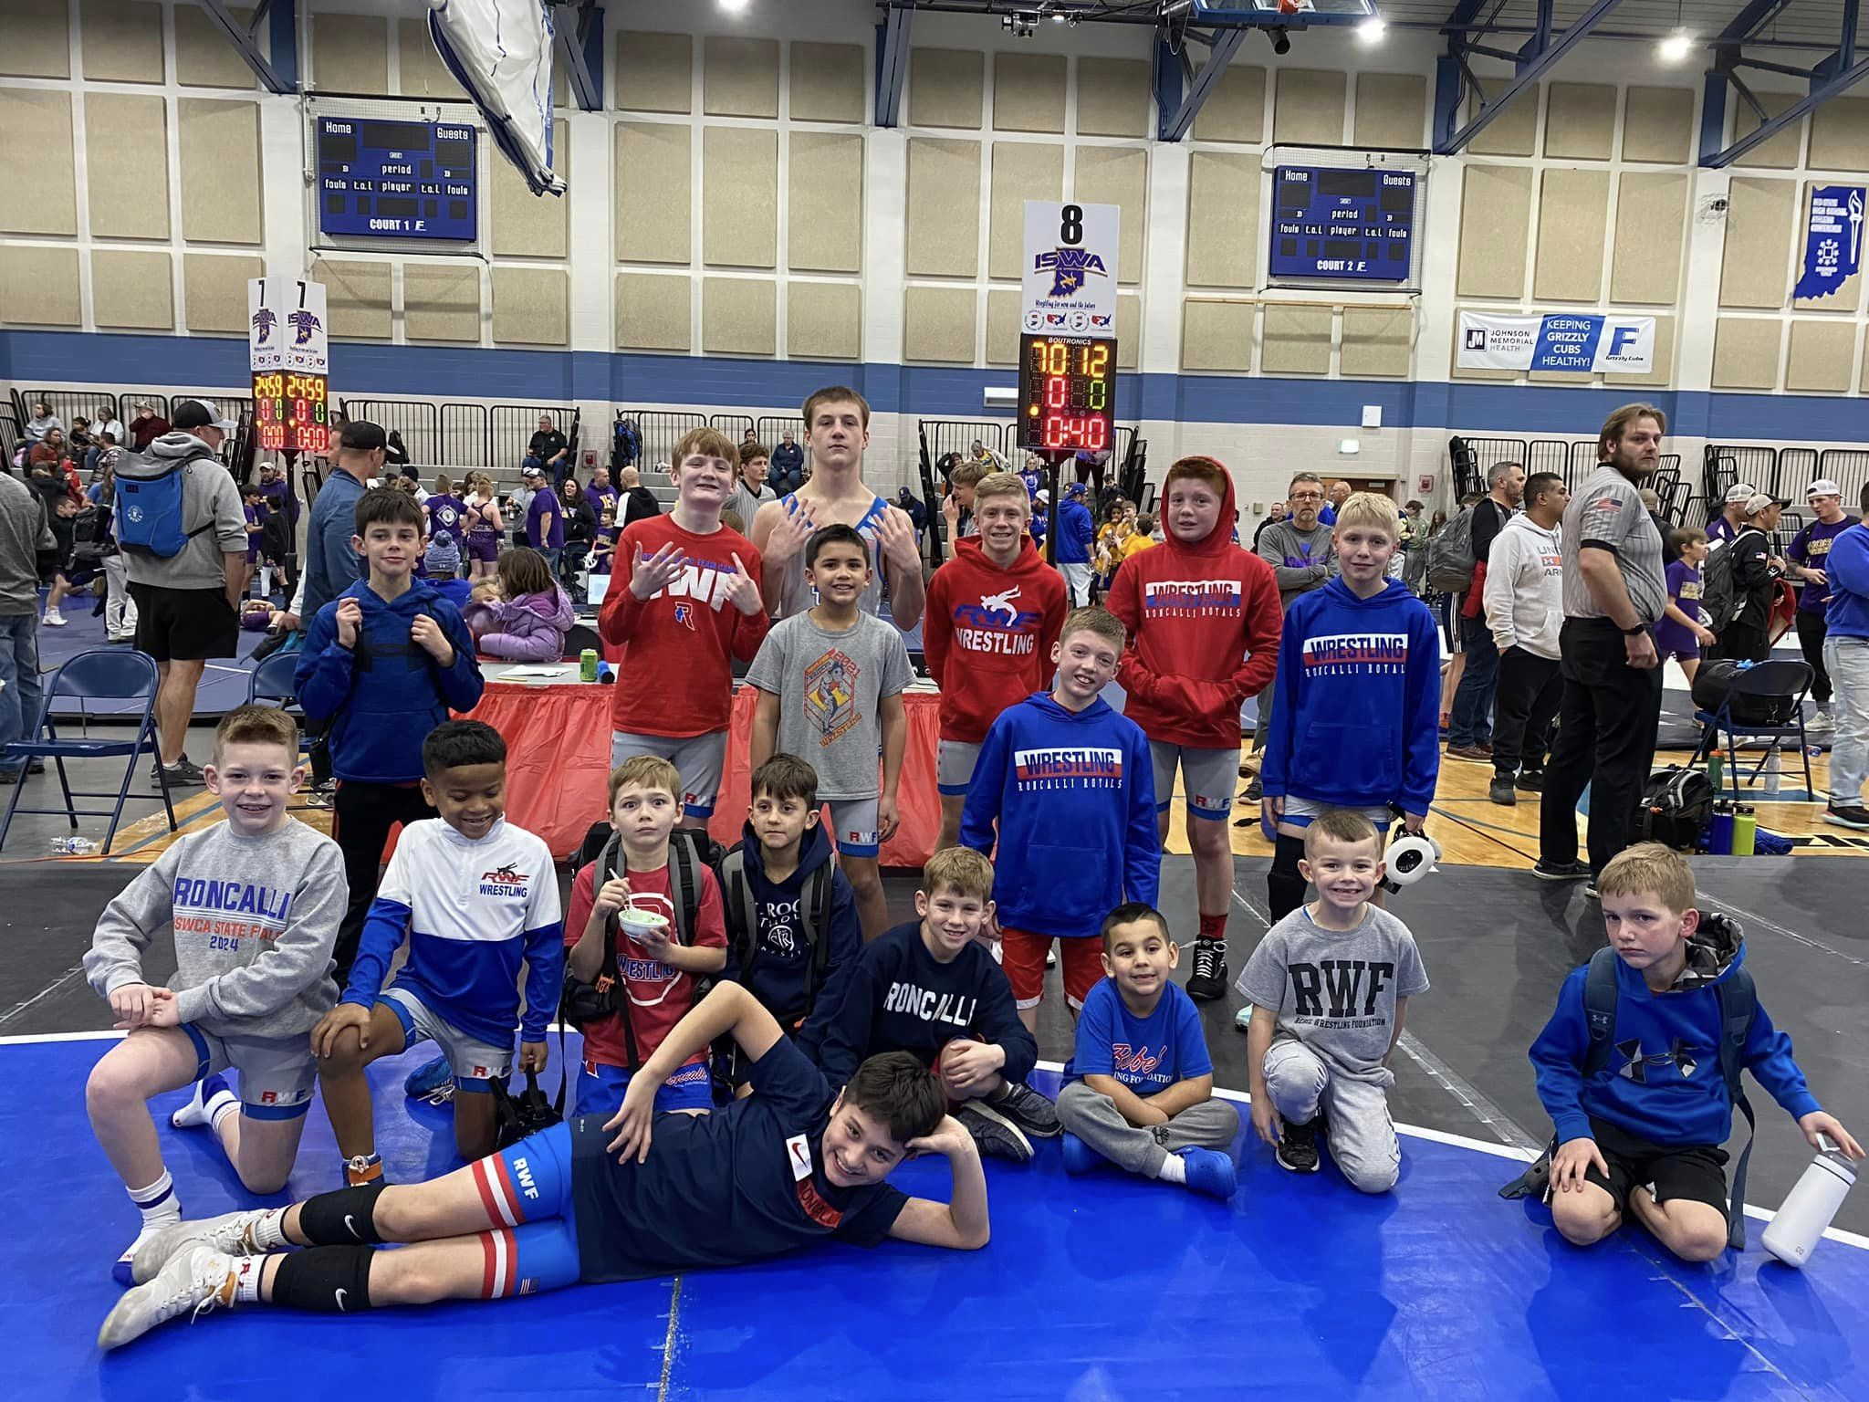
Our program
Beginner Group:
This group is for younger wrestlers with 0-2 years of experience. This group is for pre-k to about 3rd grade. We do make exceptions if kids are young but ready to move up.
Advanced Group:
This group is for kids that are 4th grade on up or have a few years of experience.

Slide 5
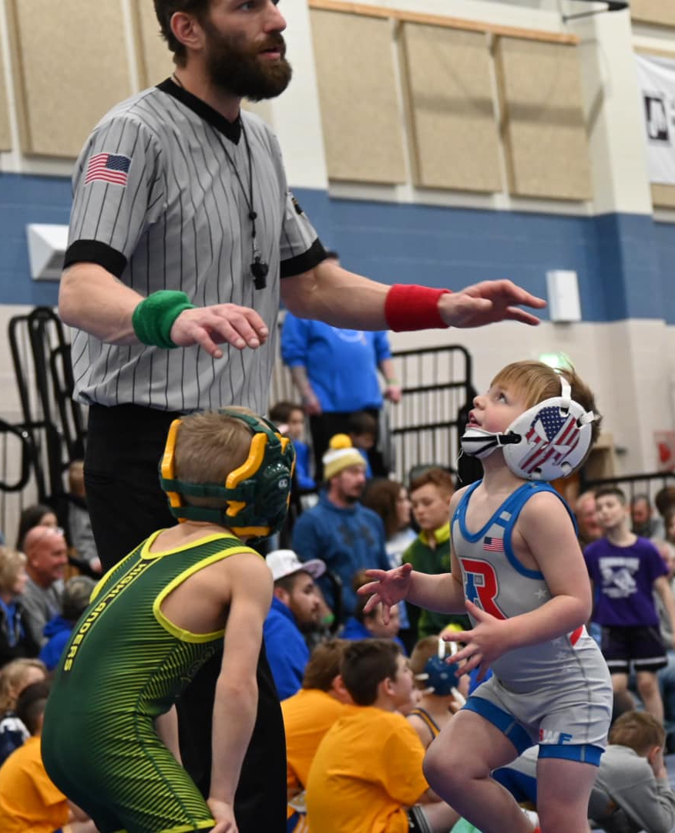
Beginner Group Purpose (pre-K to 3rd grade 0-2 years experience)
Our beginner group designed to introduce kids into wrestling with games and drills. Goal of developing athleticism, flexibility, discipline, functional strength, fitness, and teaching basic wrestling skills. This group does not focus on competition.

Slide 6
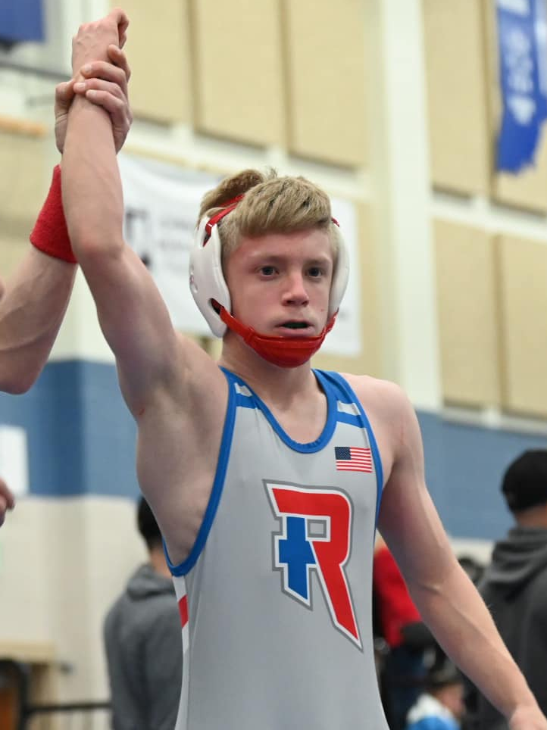
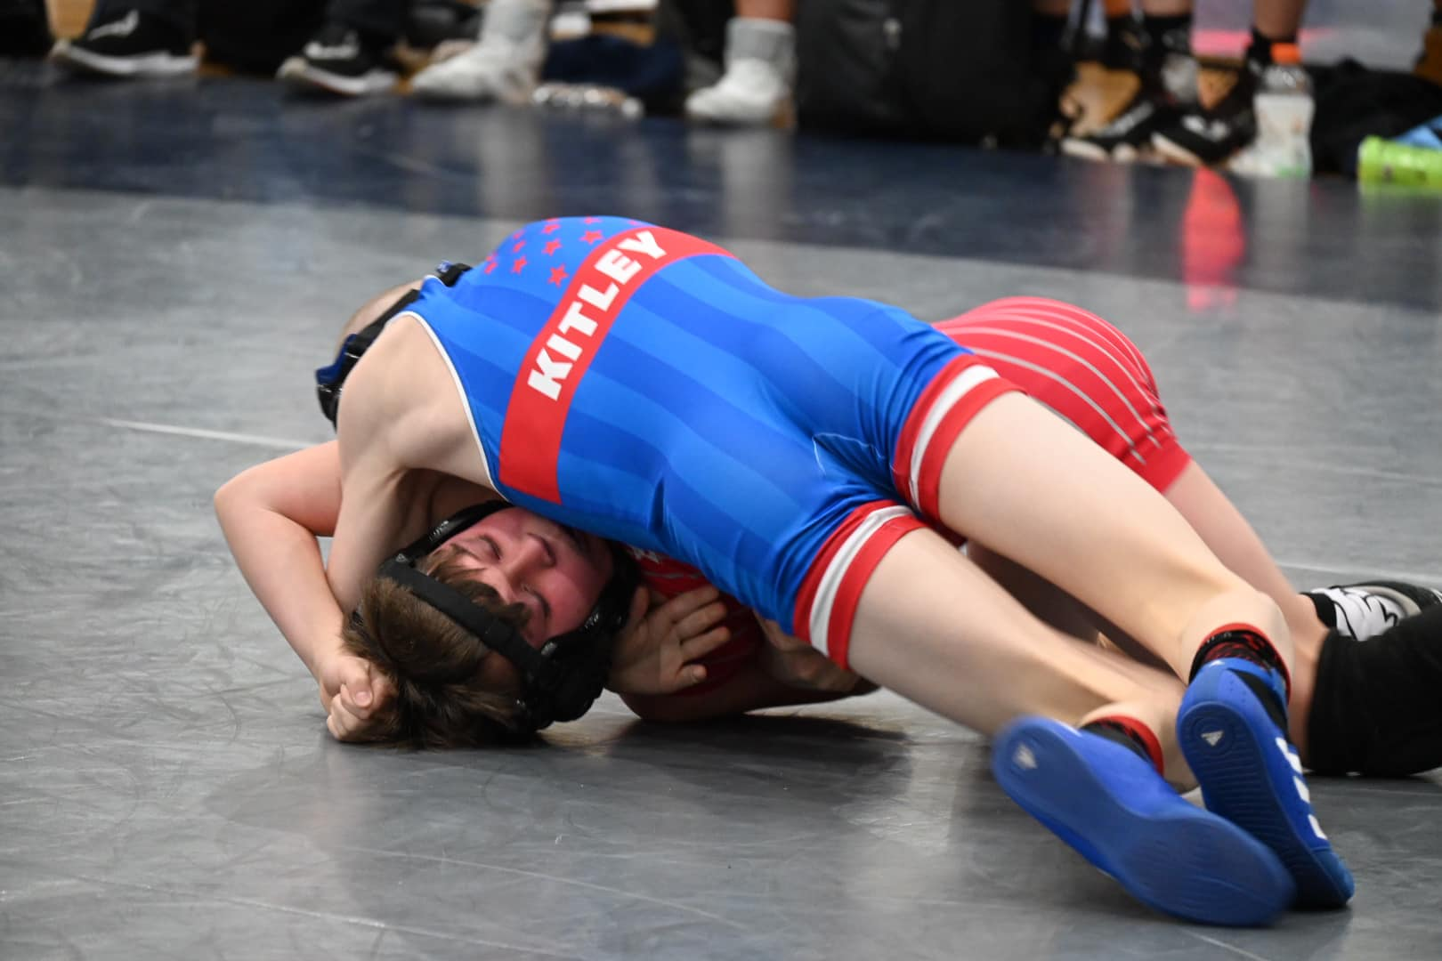
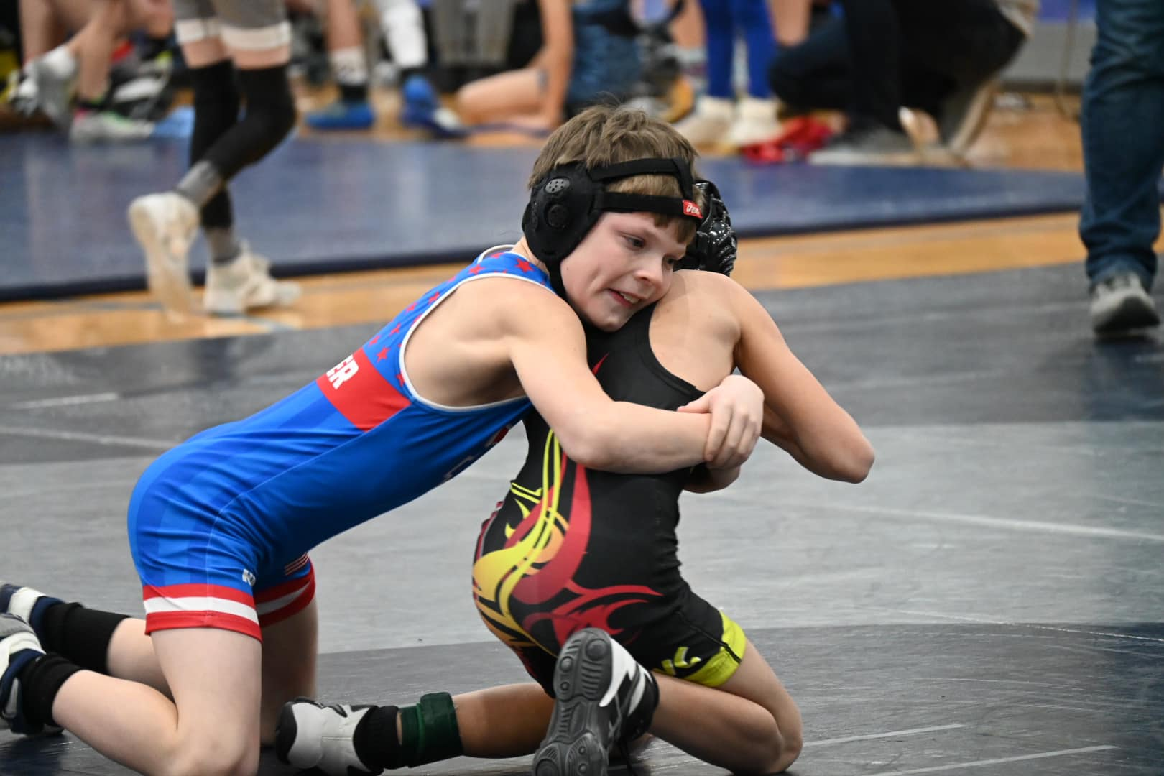
Advanced Group (4th grade to 8th grade)
To prepare wrestlers for a competitive schedule, more small group training, develop wrestling skills that will transition into our middle and high school wrestling programs. This group will compete in duals as a team and individual tournaments.

Slide 7
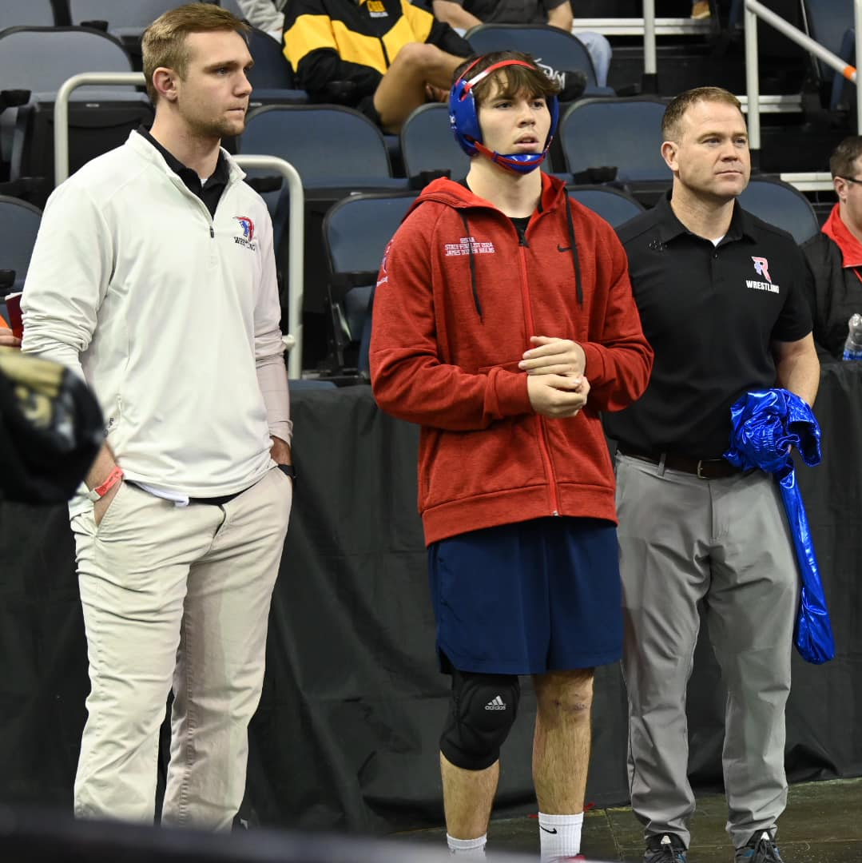
Meet the Coaches
Coach Richardson
HS state champ/runner-up
Wrested at UINDY
USA Bronze Certified
RHS Head Coach
Coach Warren
HS State Champ/Runner-up
Wrestled at Marian University
RHS Assistant Coach
Coach Kelly
HS Semi-State Qualifier
USA Bronze Certified
10 years of Coaching Exp.
RHS Girls Wrestling Coach
Coach Slayman
HS Semi-State Qualifier
USA Bronze Certified
18 Years of Coaching Exp.
RHS Assistant Coa
ch
Coach Odum
Wrestled at UINDY
USA Silver Certified
RHS Assistant Coach

Slide 8
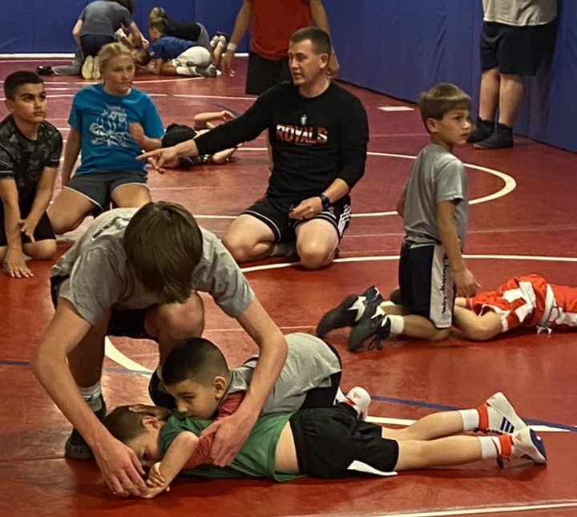
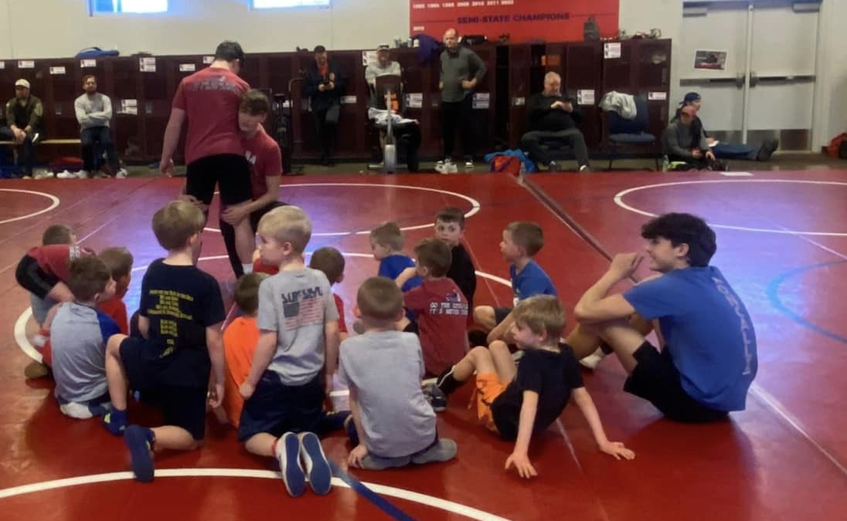
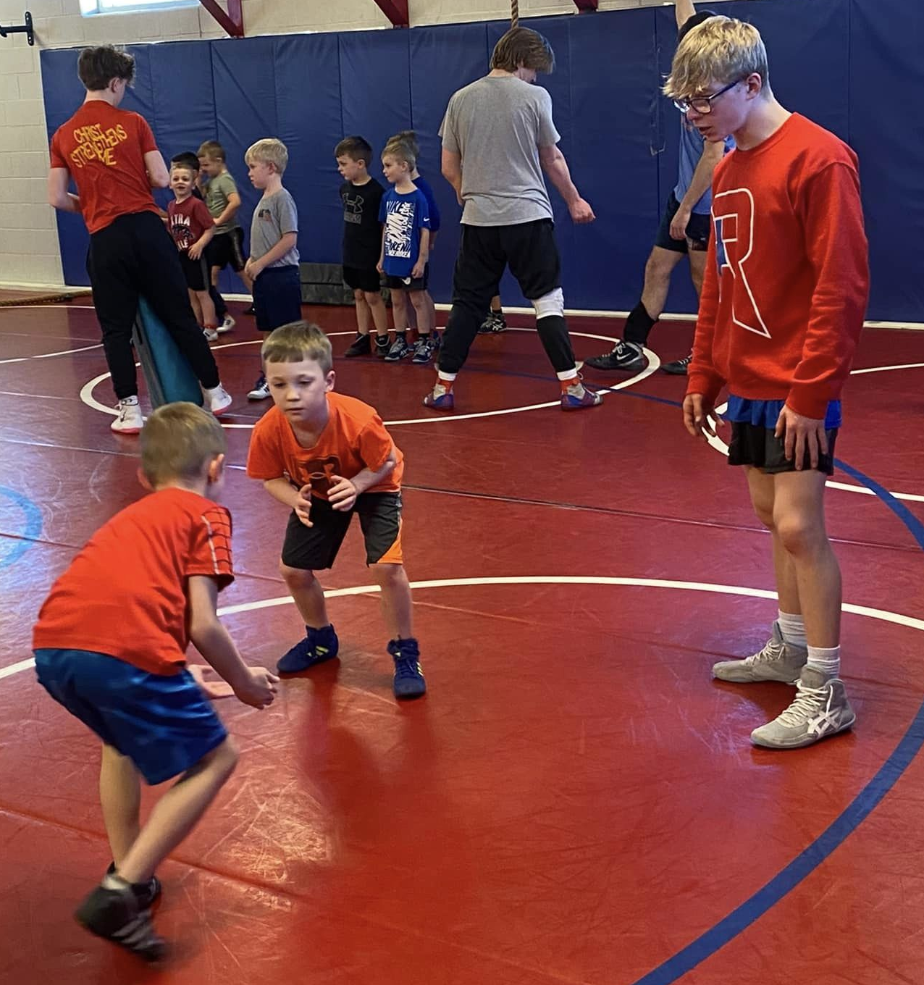
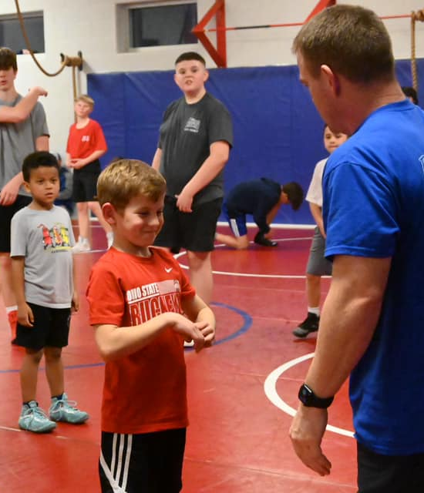
Still not sold….FREE WRESTLING CLINIC Monday 10/14!
We will have a free one day clinic. This would be a great time to check out what practices look like and meet some of the coaches. We will have some of the high school guys to help, so you can ask questions etc.
Beginner Group 5:30-6:15
Advanced Group 6:30-7:45

Slide 9
Frequently asked questions:
What is an appropriate age to start wrestling?
- If your child can be attentive for a 45 min practice, participate, and follow directions, they are old enough for the Little Ninjas group.
Is there any required special equipment?
- For club practice kids need athletic wear(shorts or sweats and t-shirt). For competition kids need wrestling shoes, headgear, mouthpiece, and a singlet (we have loaner singlets and headgear for those new to competing).
When should wrestlers begin entering competitions? - Every wrestler is different. Coaches will help communicate on an individual basis when we believe a wrestler is ready for competitive matches. We typically suggest going through a full season with no competition at all for 1st year K-3rd ages.
What about CYO?
The CYO season will start in January. RWF is in addition to the CYO season. Our middle school CYO groups will continue to practice at the same time together at RHS. The younger groups will have their own CYO practices on Mondays and Wednesdays. The club season provides more practice and competition.
What if we can’t make it to the first couple practices(football, cheer, dance, etc)?
No problem. We just want to start early to get those that are finished with fall activities the chance to practice. You can start as soon as you can make it.

